Slide 1



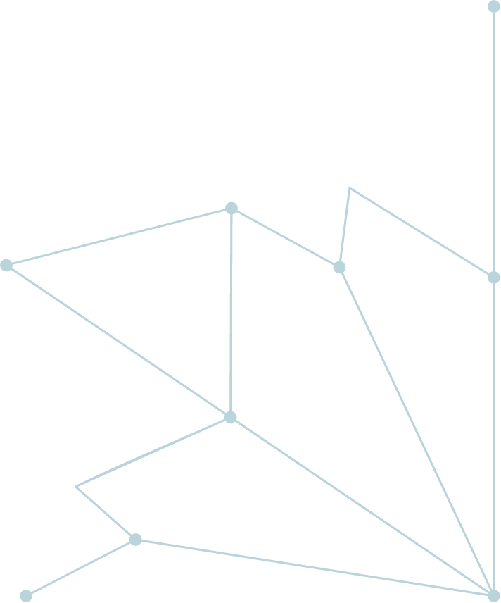

All about Generative AI - LLMs & GPTs
Multi-Tiered AI & Data Management Training Program for Northern Command

Slide 2

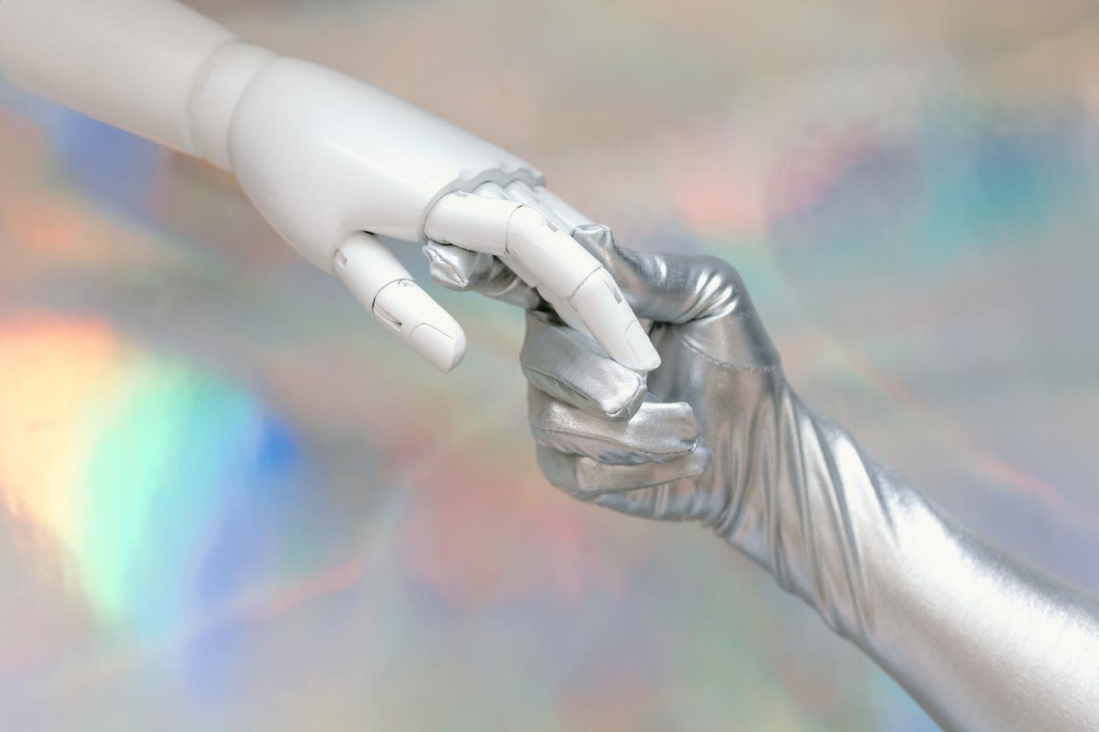
Why not RNN?
Still Sequential and takes more time to learn.
Also cannot handle a very long text say 1000 words (Not that effective to handle the longer sequences.)
RNN Slower in process. (LSTM also slower in process)
RNN expects to give the input in serially or sequentially to process them and such sequential flow doesn’t make use of the GPU very well which developed for parallel computation.
CAN WE USE THE PARALLELIZATION FOR SEQUENTIAL DATA???

Slide 3
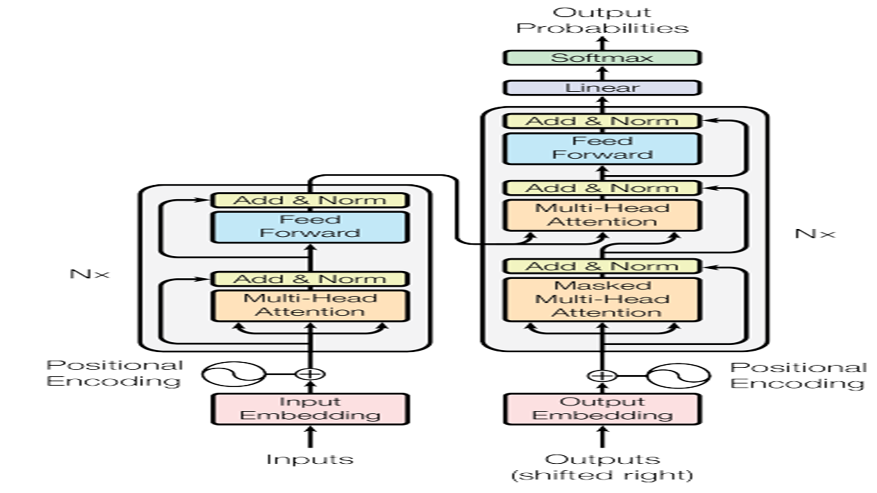
What is Transformer?
The transformer neural network is a novel architecture that aims to solve sequence-to-sequence tasks while handling long-range dependencies with ease.
A deep learning architecture that relies on the parallel multi-head attention mechanism. (Parallelize the Sequential Data)
“Attention Is All You Need” presents a novel approach to sequence-to-sequence tasks that relies solely on self-attention mechanisms, without using recurrence or convolution. And this novel shaping the way we think about and approach NLP problems.
The transformer network employs the “Encoder & Decoder” architecture. The input sequence can pass in parallel to the architectures.

Slide 4
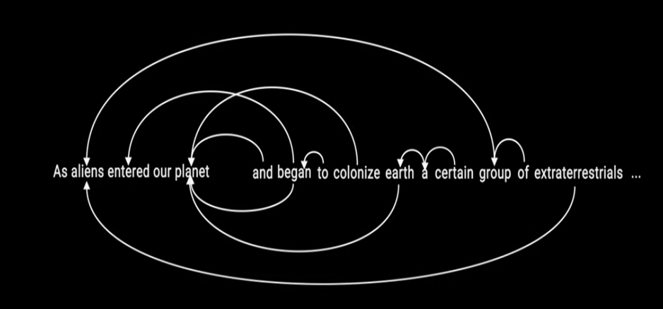
What is Attention?
The attention mechanism is a part of a neural architecture that enables to
dynamically highlight relevant features of the input data, which, in NLP, is typically a sequence of textual elements.
Attention Mechanism in other word embedding is not possible since the window size is smaller to compute the relation for large corpus data.
LSTM & GRU also can able to handle some certain number of words but not like the entire sentence because it’s memory doesn’t allow to perform

Slide 5
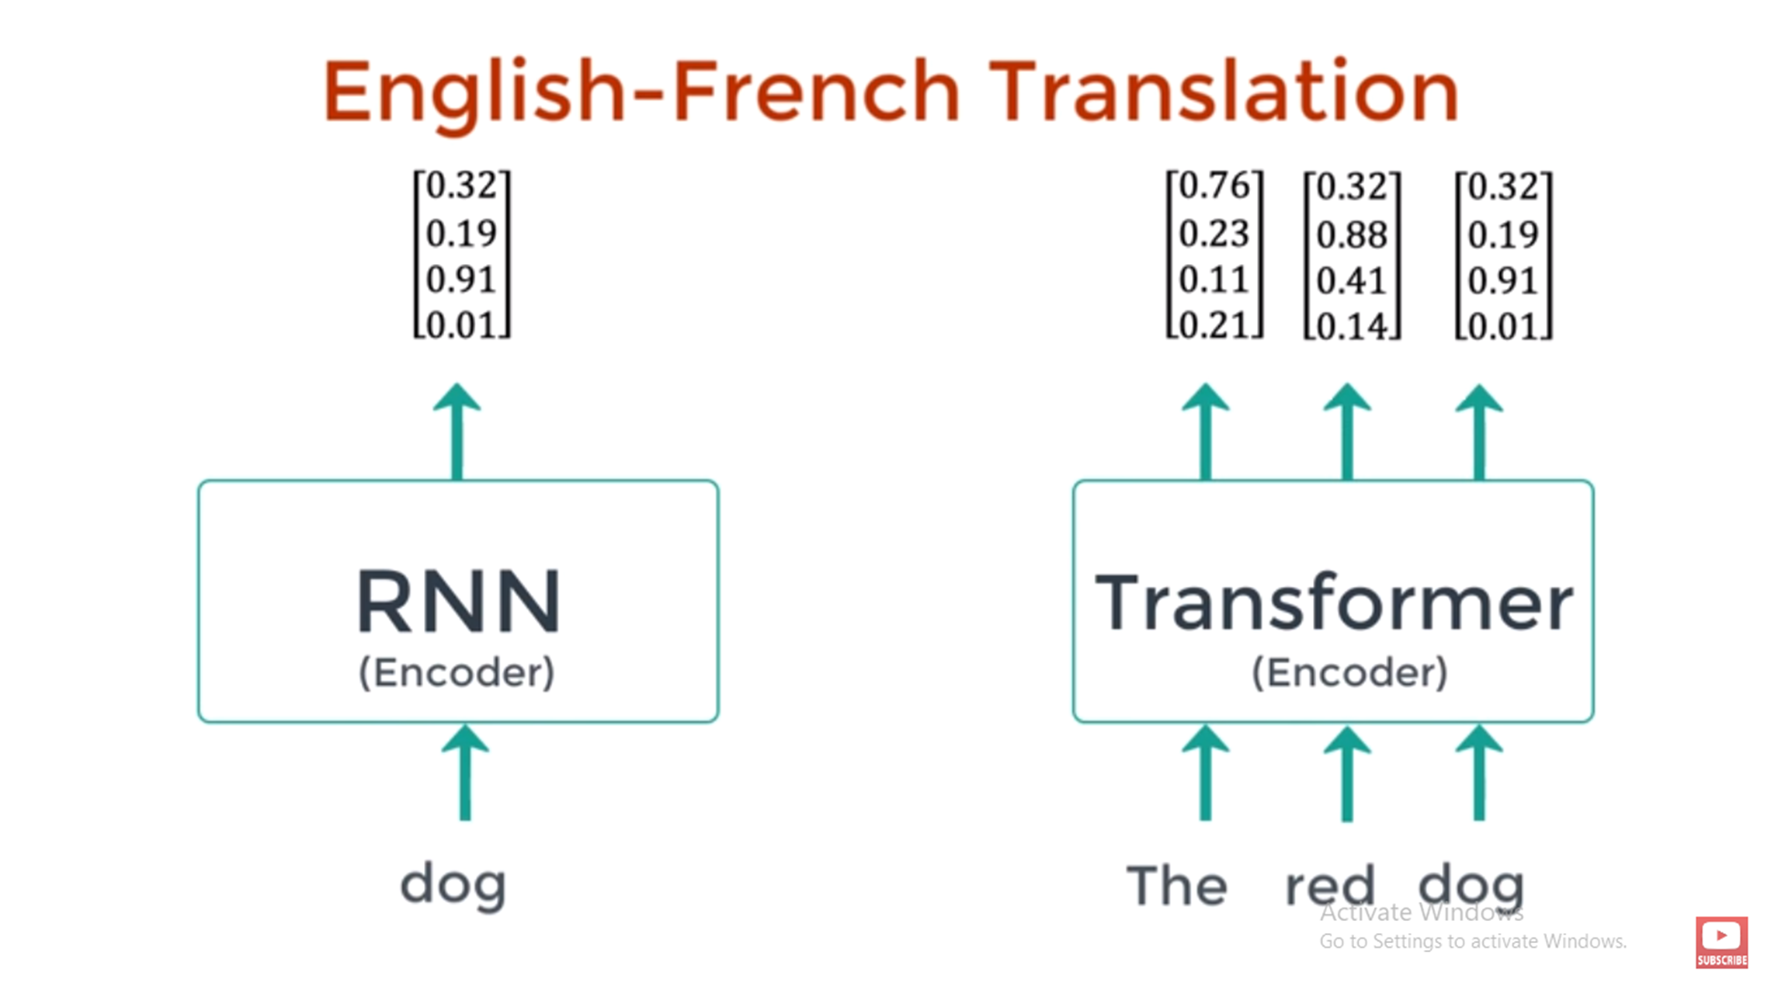

Let’s learn the components of the architecture
In RNN - Since it’s sequential, the process will happen in sequentially
Transformer - Where parallel is possible to treat all the data simultaneously

Slide 6
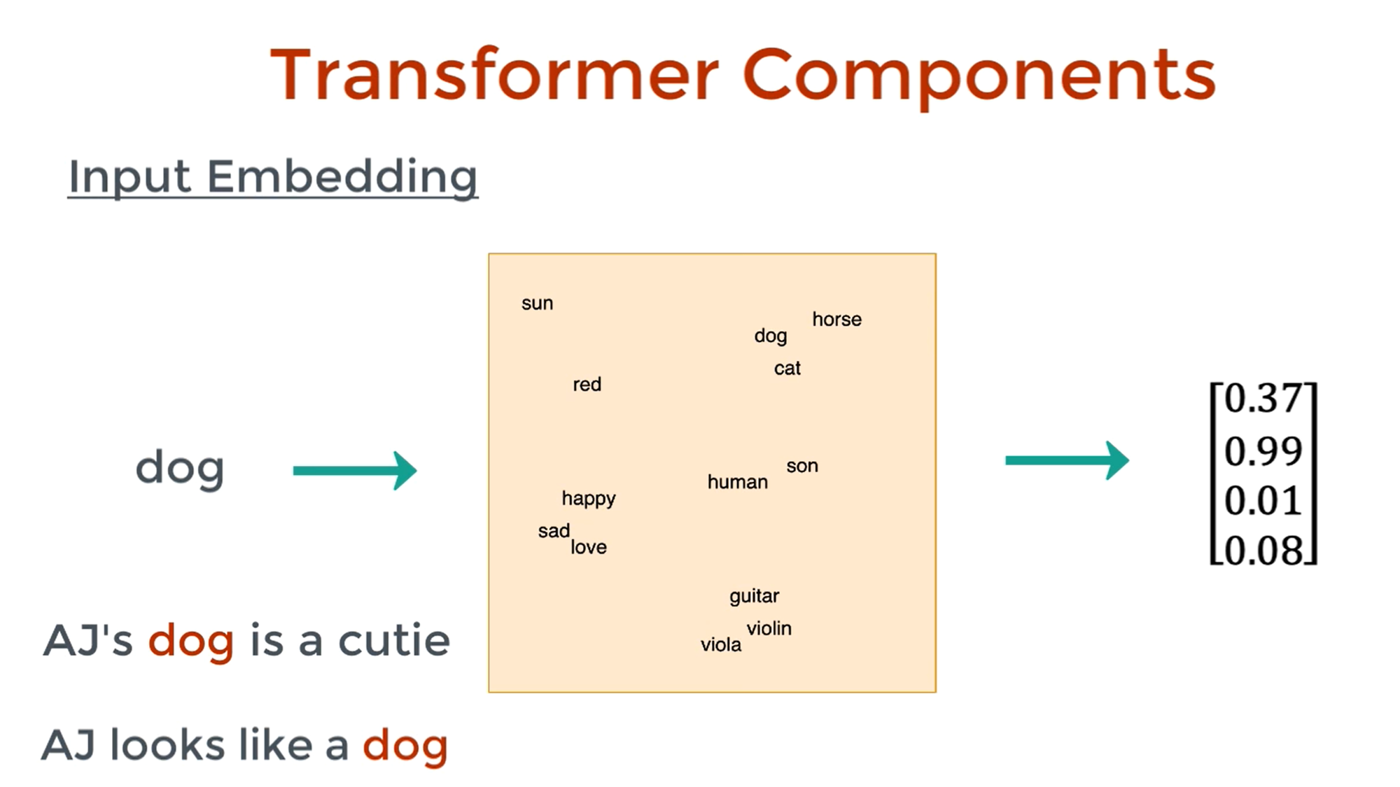
Input Embedding
Models cannot directly understand words or symbols.
Input embeddings translate each input (like a word, token, or item) into a dense vector of numbers that captures its meaning.

Slide 7
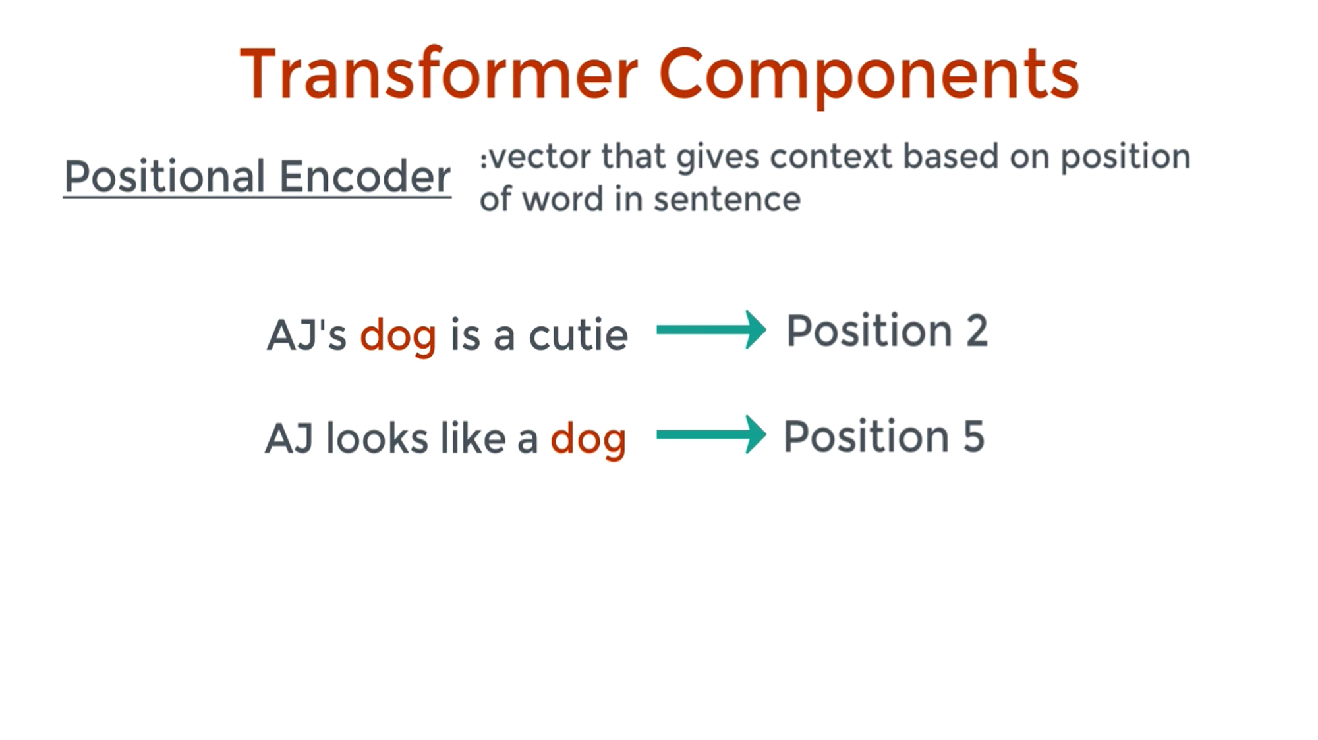
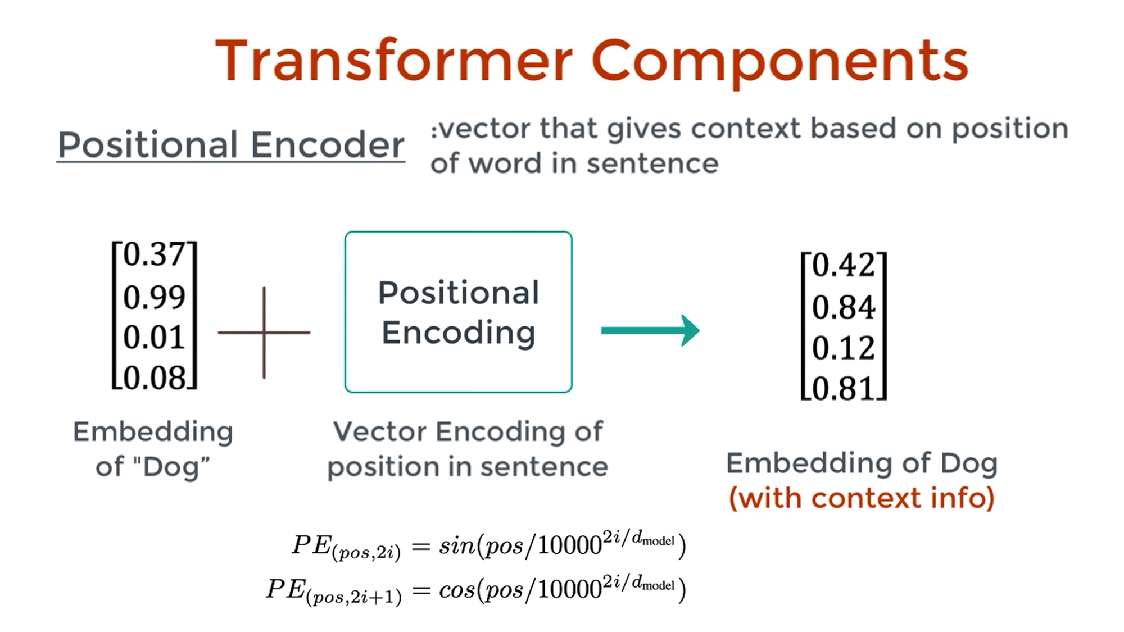
Positional Encoding
Positional embedding is a mechanism that injects word order information into Transformer models.

Slide 8
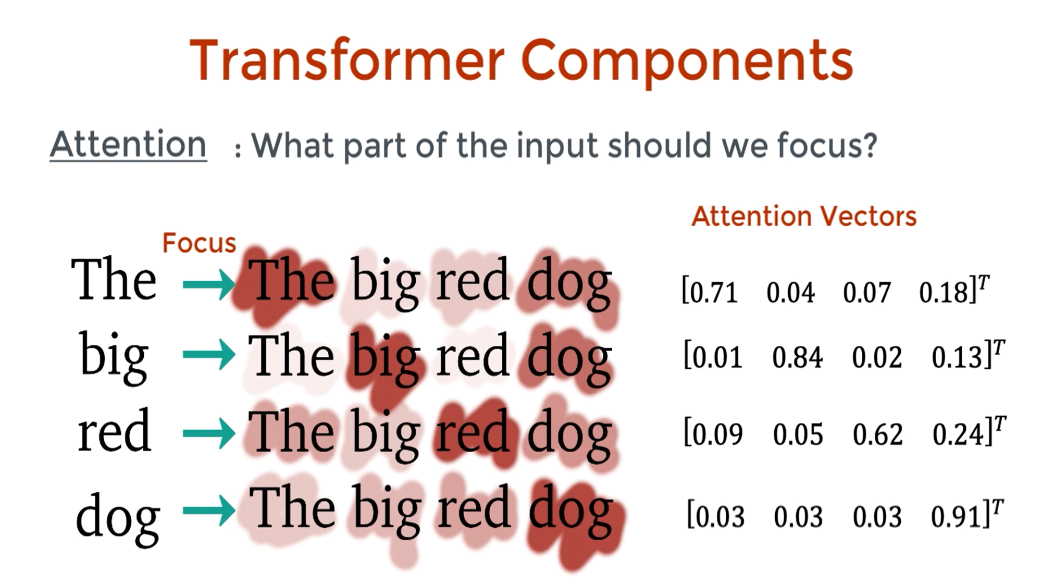
How attention focus on the inputs?

Slide 9
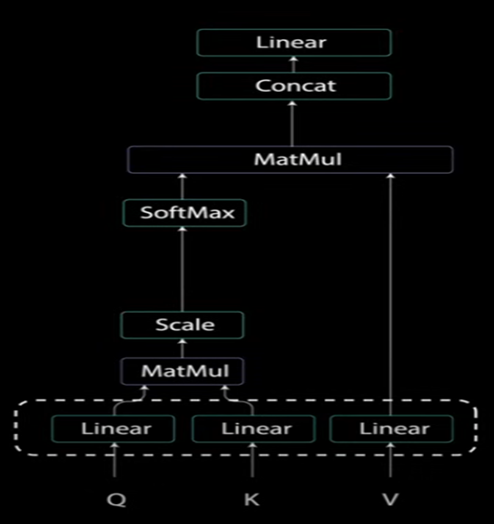
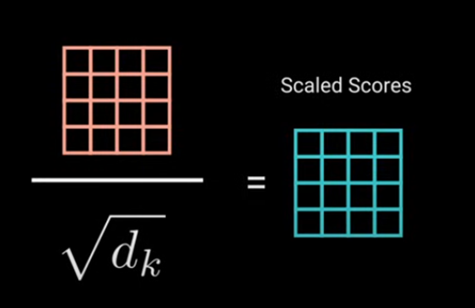
Multi-Head Attention
Data: “The dog chased the cat because it was hungry.”
When predicting what “it” refers to:
Query (for “it”) asks: “Who in the sentence is hungry?”
Key for “dog” contains info like “animal, can be hungry” → high match.
Key for “cat” contains info like “animal, prey” → maybe lower match.
Attention weights make “dog” more relevant, so the model pulls Value from “dog” to interpret “it” correctly.
The Actual Attention Process in Plain English
Every word turns into Q, K, V vectors through learned weights.
Your current word’s Q is compared to all words’ K to find relevancy scores.
Softmax turns scores into “attention percentages.”
Weighted average of Vs from all words forms the context for your word.

Slide 10
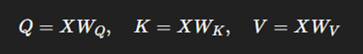
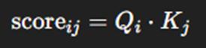
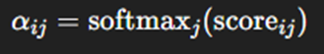
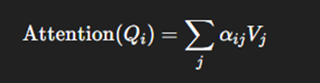
The Roles of Q, K, V & how they react
These (Q, K, V) vectors are produced by multiplying the input embedding by learned weight matrices:
X = input embeddings matrix WQ,WK,WV​ = learned parameter matrices
Step 1: Similarity score (Query vs. Key):
We compare each token’s query Qi with every other token’s key Kj​ to see how relevant they are. Mathematically:
Step 2: Normalize scores (Softmax)
We turn these scores into probabilities:
This means αij​ tells us “how much should token i attend to token j?”
Step 3: Weighted sum of Values
For token i, we combine all Vj​ vectors weighted by αij​:
This gives a context vector that’s a blend of relevant information from all tokens.

Slide 11
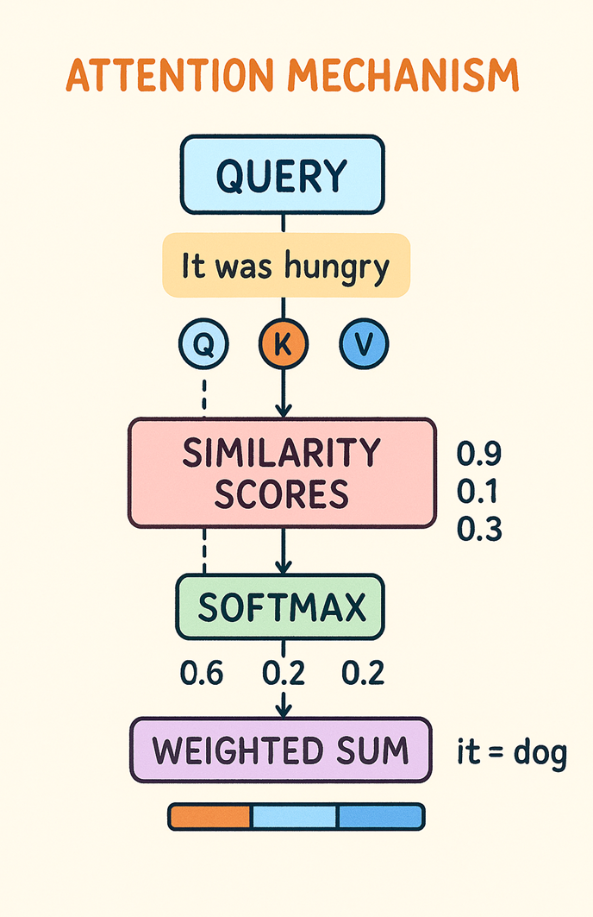
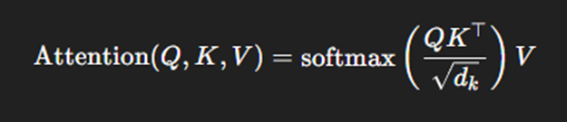
Full Attention Formula
Where:
QK⊤ → similarity of all queries with all keys
softmax → convert scores into attention weights
Multiplying by V → blend information

Slide 12
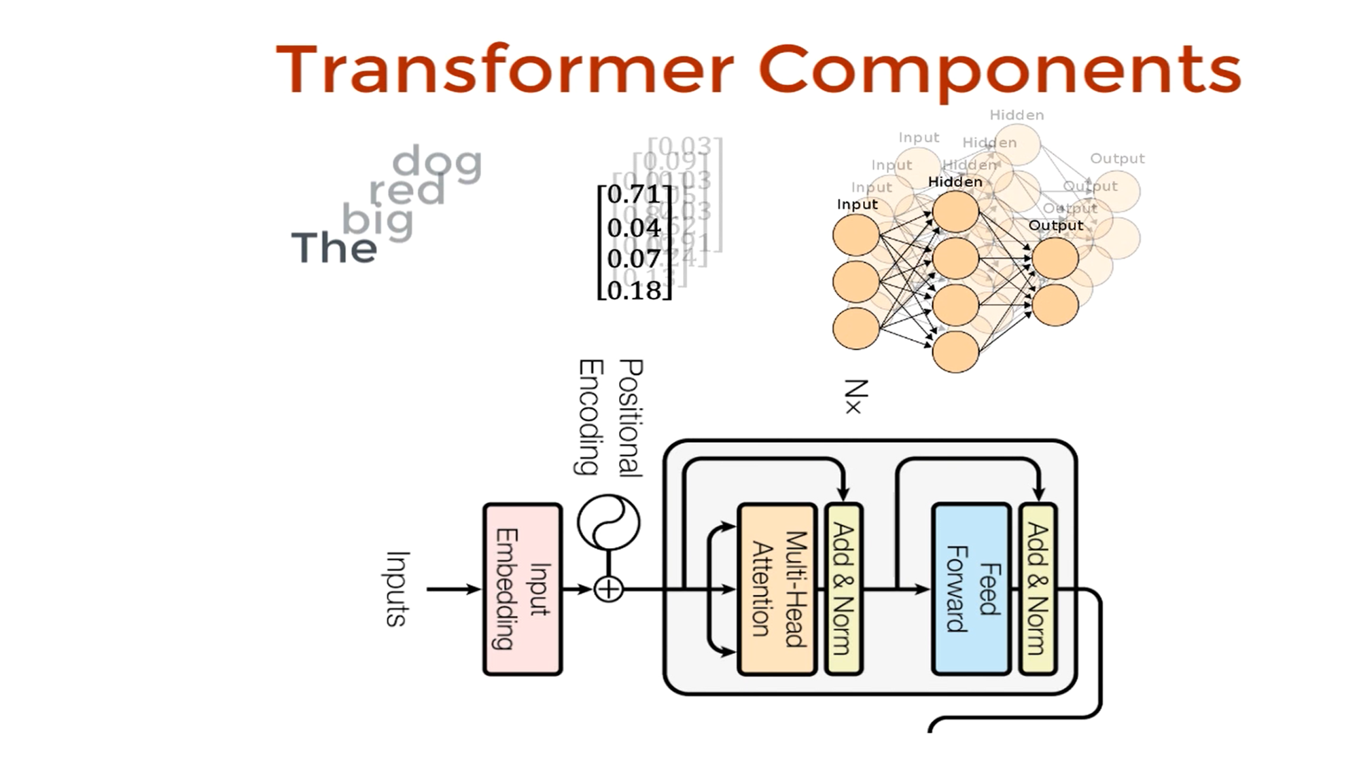
Encoder Architecture Flow - Review

Slide 13
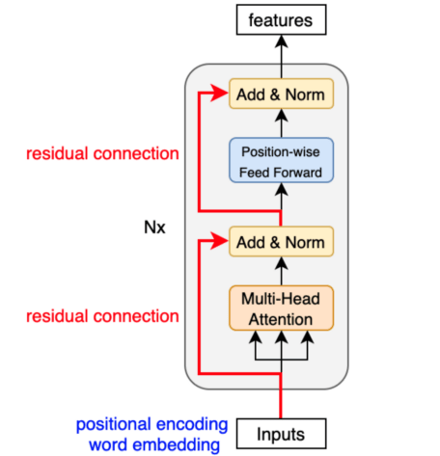
What is Add-Norm Layer?
Residual connection – Combination of Input embedding + multi-head attention output vector
Layer normalization - This Feed forward network which helps to stabilize the network with proper gradient computation.
Point-wise feed forward network – It accepts the input as layer normalization output along with attention output to enrich the representation of vector.

Slide 14
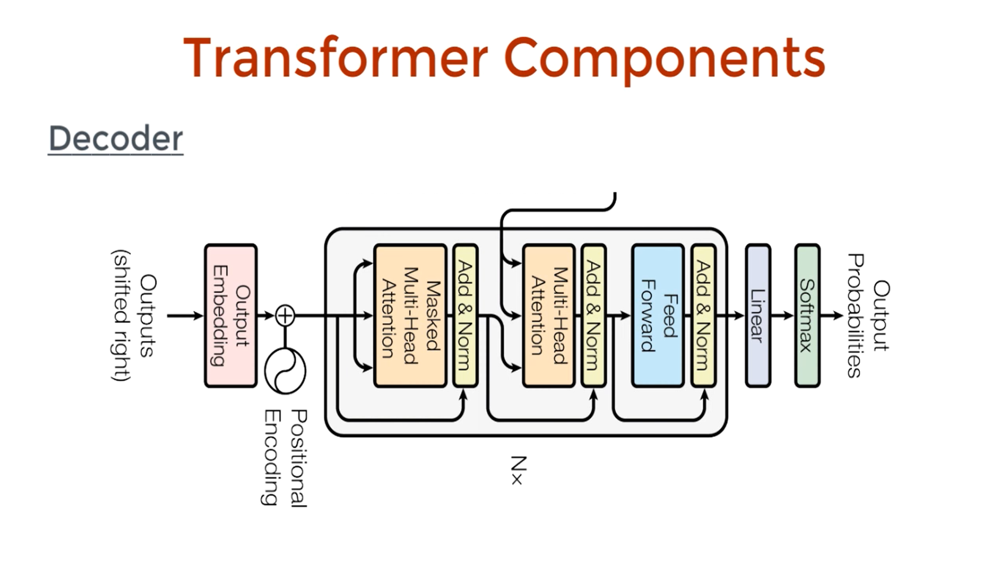
Now it’s turn to Decoder Architecture
A Transformer's decoder architecture generates output sequences (like translated text) by using three main sub-layers per block: a Masked Multi-Head Self-Attention layer to understand previously generated tokens, a Cross-Attention layer to focus on relevant encoder output, and a Feed-Forward Network, all combined with residual connections, layer normalization, and finally, a linear layer and softmax for outputting probabilities.

Slide 15
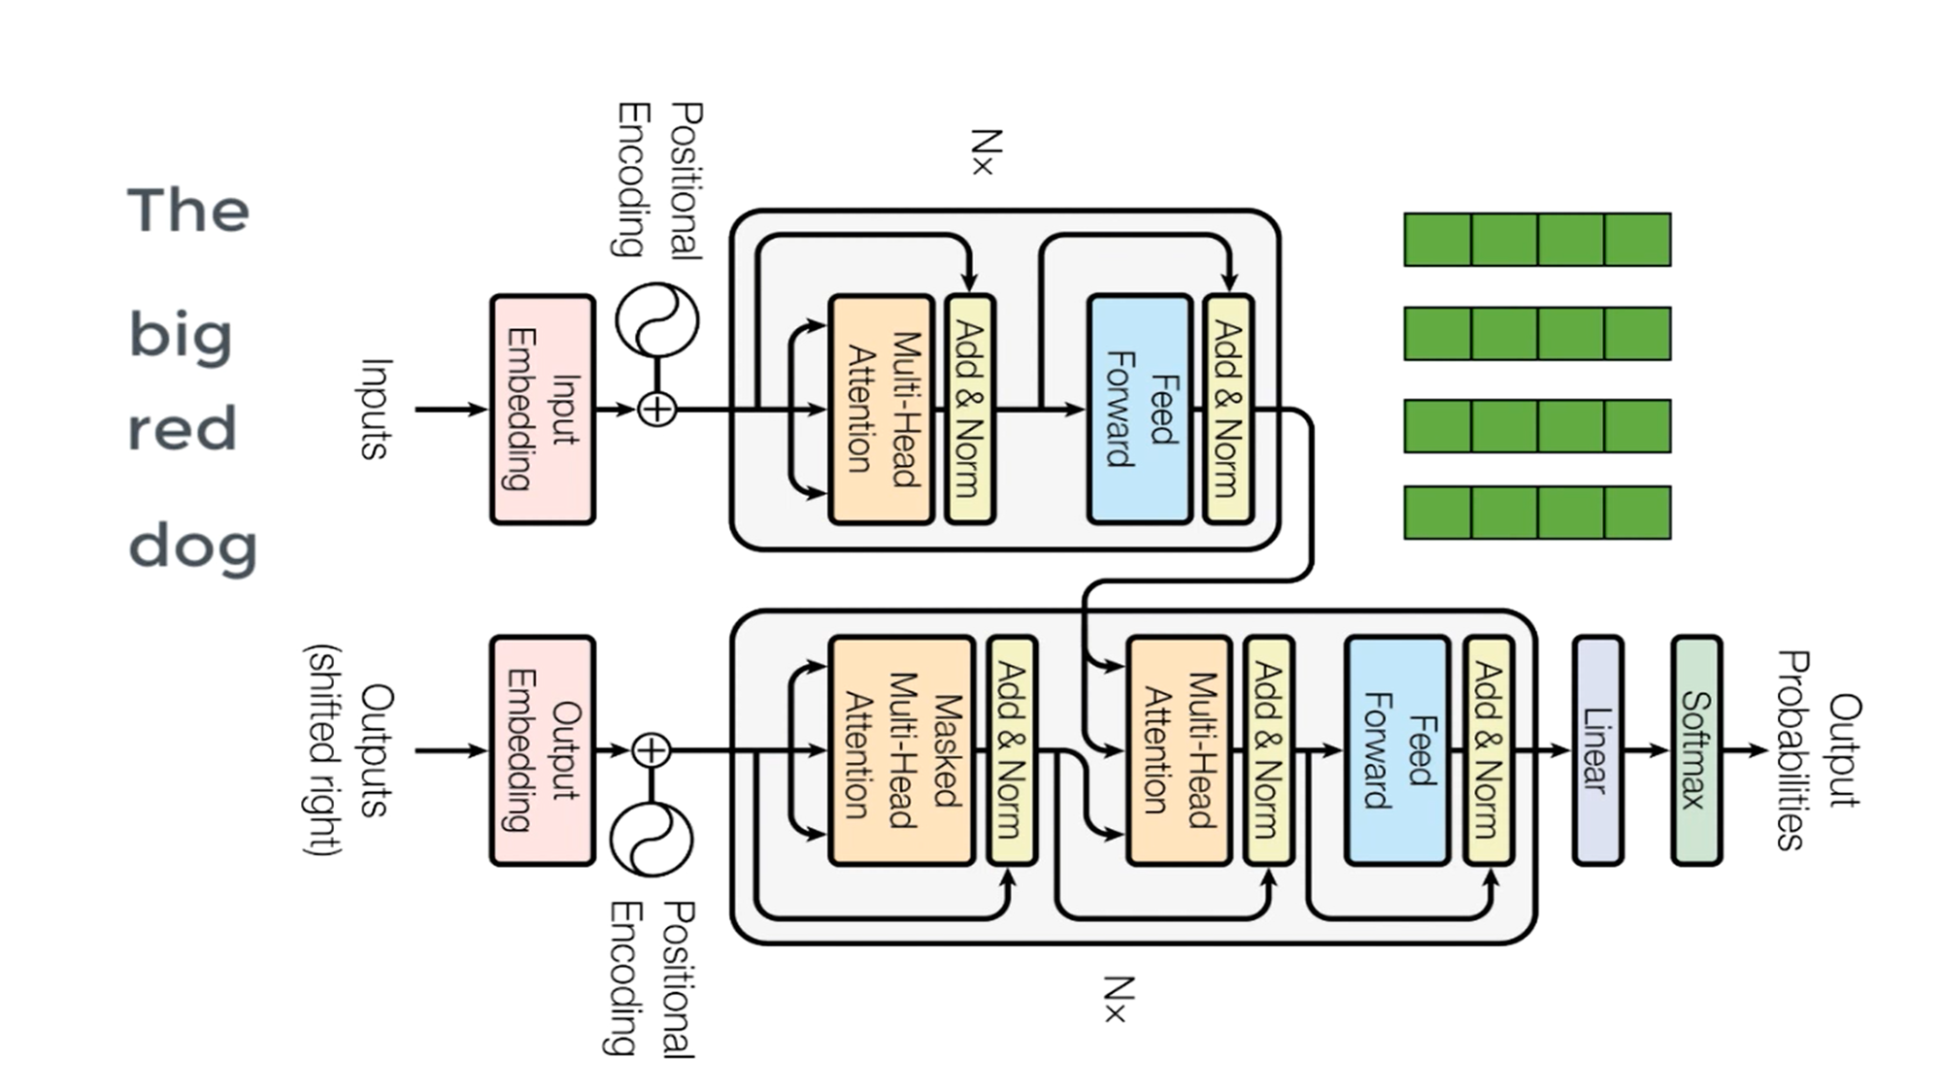
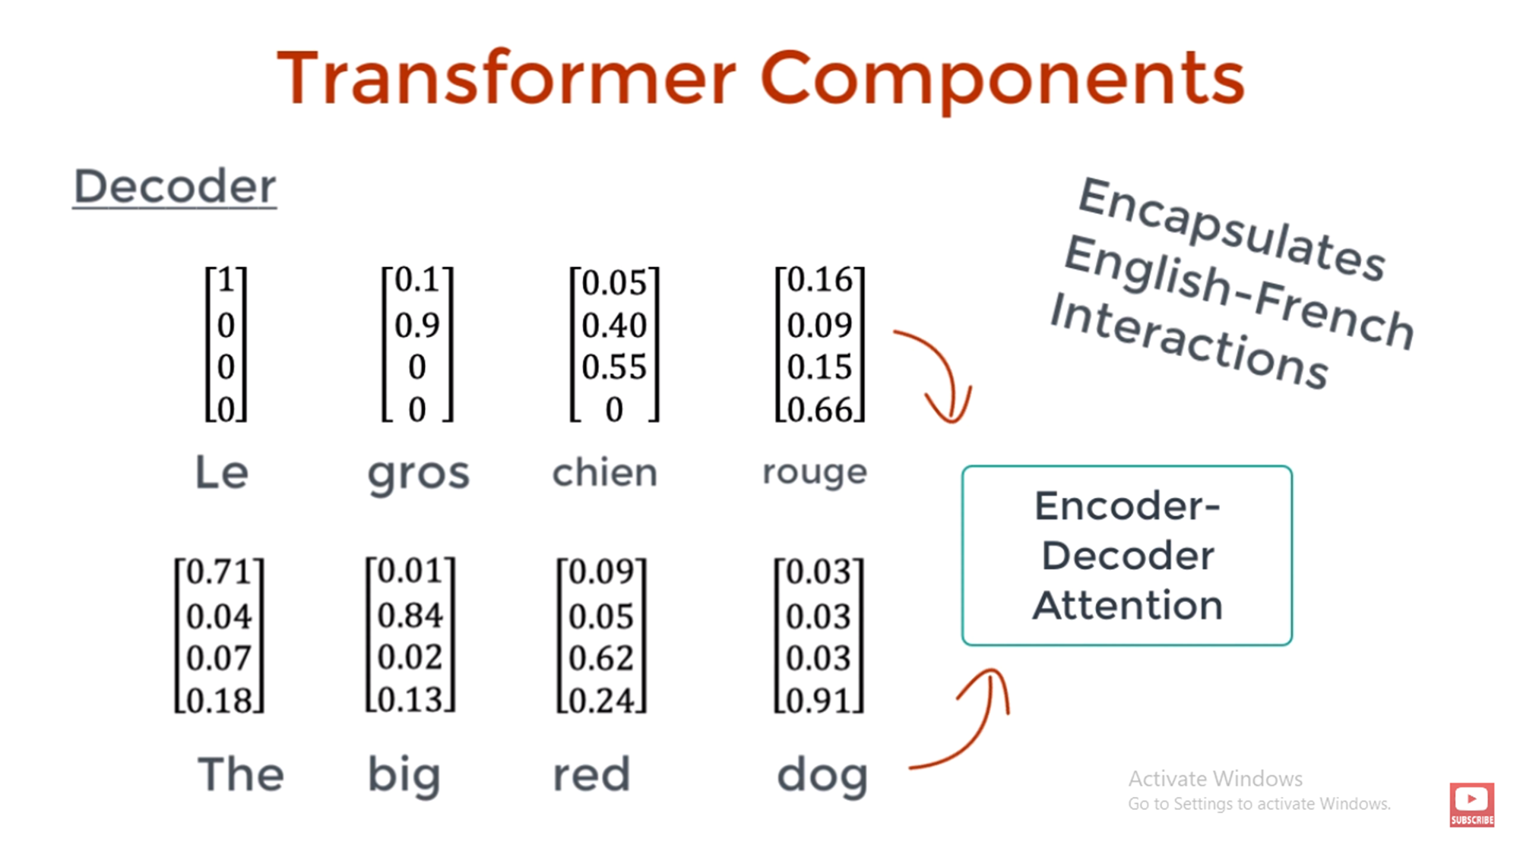
How decoder architecture generates the data?

Slide 16
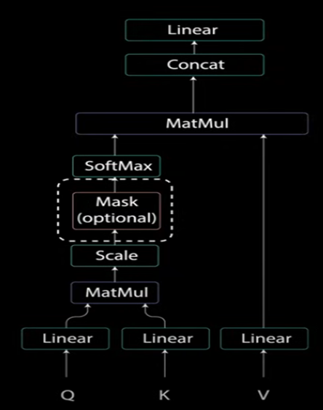
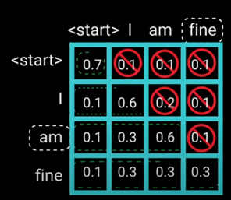
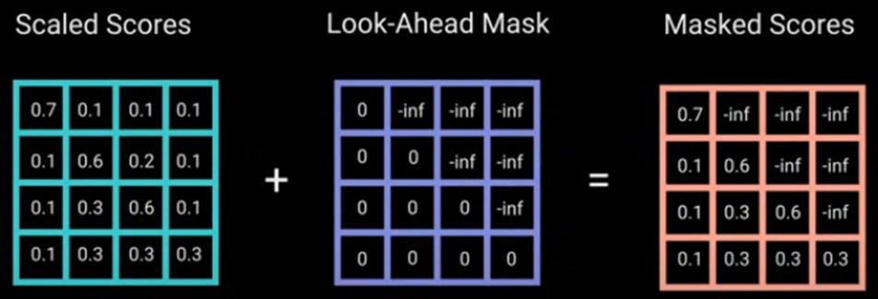
Masked Multi-Head Attention
Masked Multi-head attention mechanism is slightly differs from
the multi-head attention.
Since decoders are auto-regressive and generates the word by
word, we need to prevent the condition into future tokens.
Eg. When it tries to compute “am” it should not have access to “fine”
Because it’s future word and it should have access to “am” and previous
Word “I”.
Method to prevent computing the attention scores for future words, it’s Called “Masking” and to implement this we use “Look-Ahead Mask”.
Final matrix will show no focus on future tokens

Slide 17
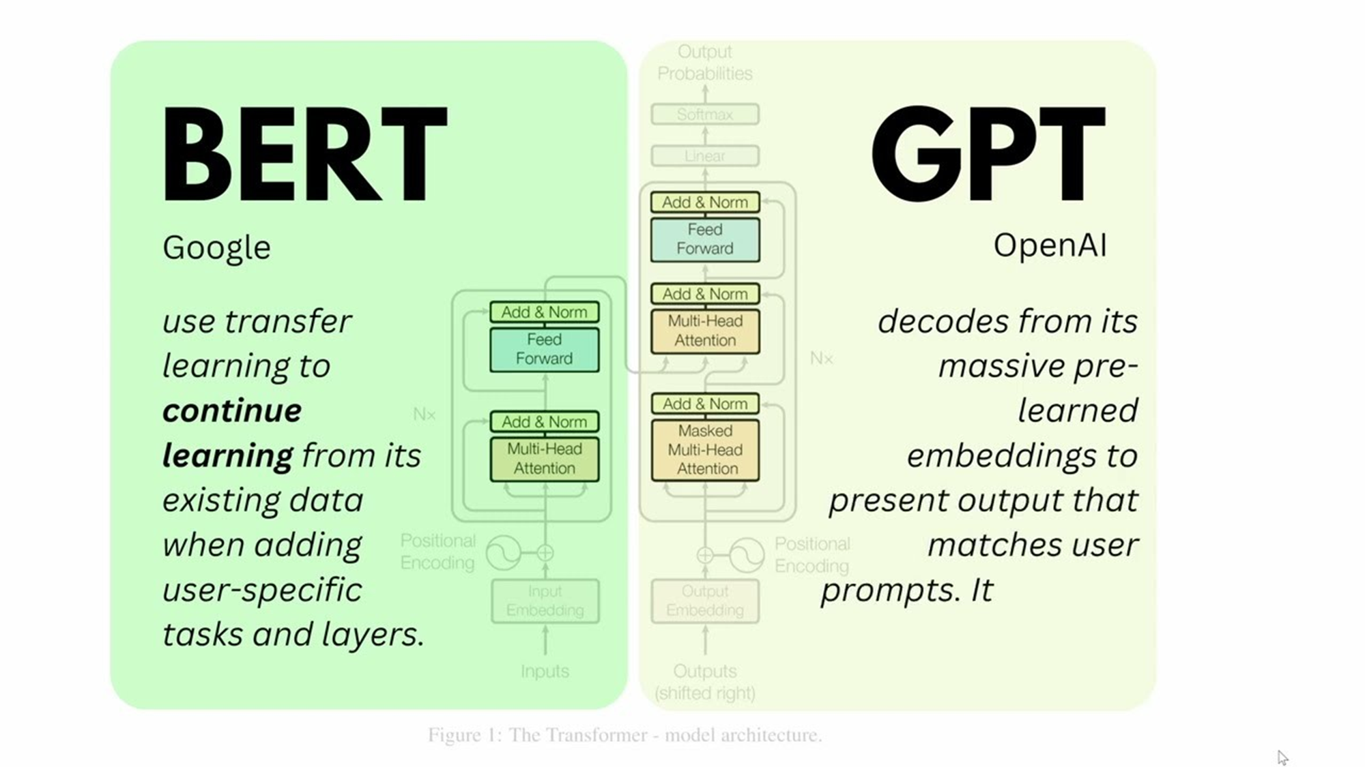

Slide 18


Slide 19
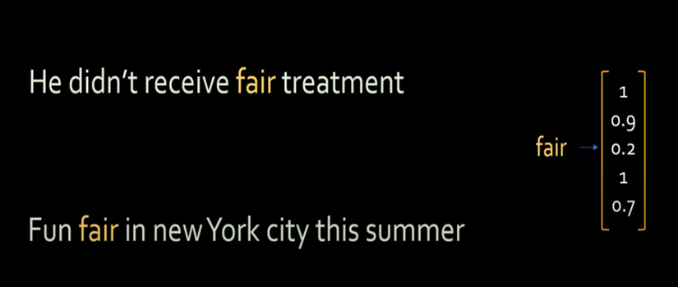
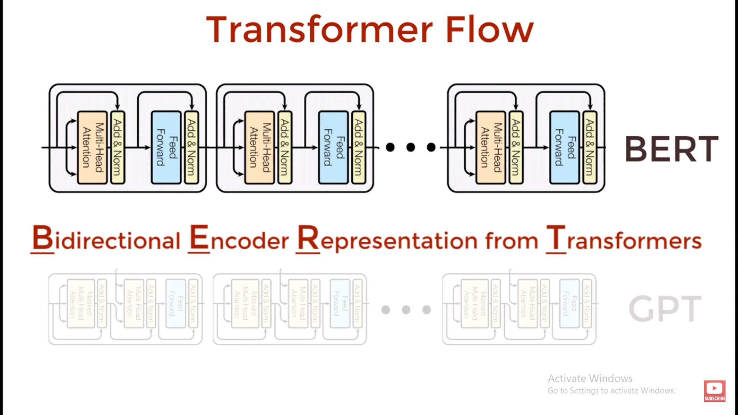
BERT- Bi-directional Encoder Representation from Transformer
Bert is contextual word embeddings. – Context based Model
Issue with Word2Vec – Fixed Embedding where as Bert can generate the contextualized embedding – Context-Free Model
Bert has a capable to generate the embedding for whole sentence as it’s window size is close to 300 with single vector on size of 768 (Bert-base)
BERT learns deep bidirectional representations
by considering the entire context (both left and right) simultaneously during training.

Slide 20
BERT- Bi-directional Encoder Representation from Transformer
BERT learns deep bidirectional representations by considering the entire context (both left and right) simultaneously during training.
Auto-regressive Language Model (unidirectional)
Auto-encoding Language Model (Bidirectional) - BERT
Sample:
The cat sitting on the wall and it has grey hairs. – Bert Can able to understand what “it” refers here and who has grey hairs

Slide 21
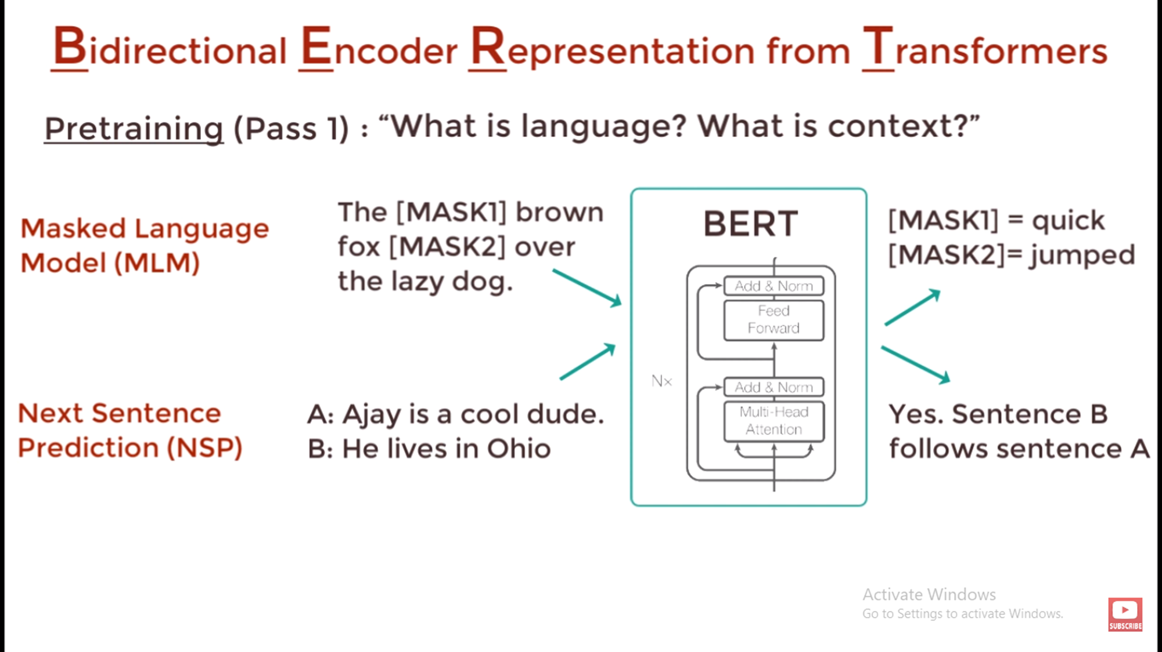
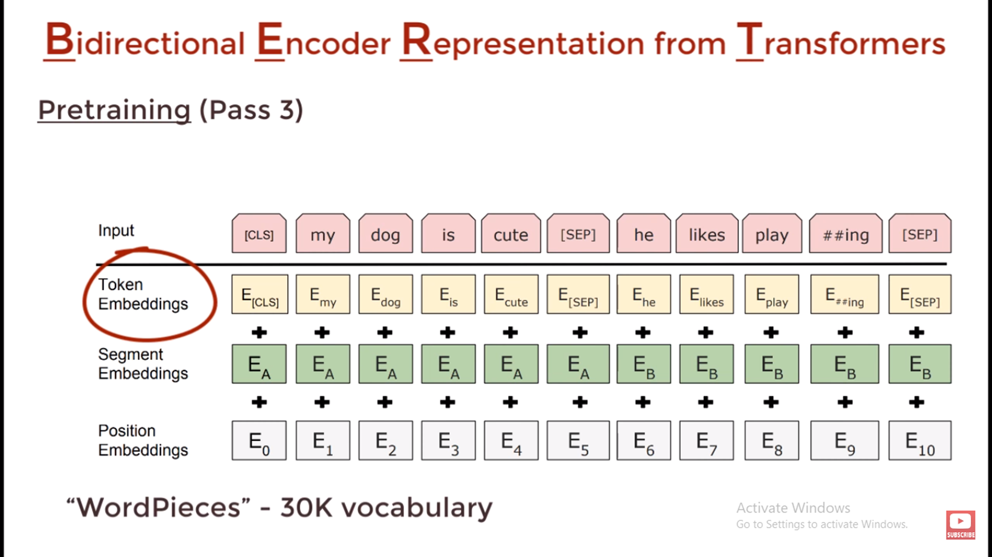
BERT- Pre-Trained Tasks
Bert – Sequence of Multiple Encoder block
GPT – Sequence of Multiple Decoder block
It’s trained with 2500M wikipedia words & 800M Google words
BERT is pre-trained on two tasks that allow it to learn bidirectional representations:
1. Masked Language Model (MLM)
2. Next Sentence Prediction (NSP)

Slide 22
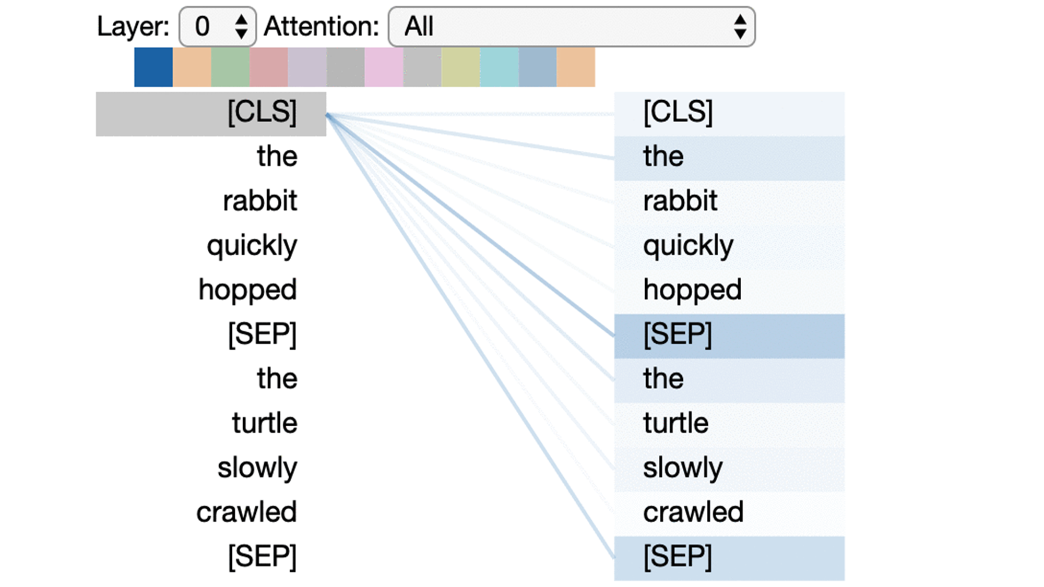
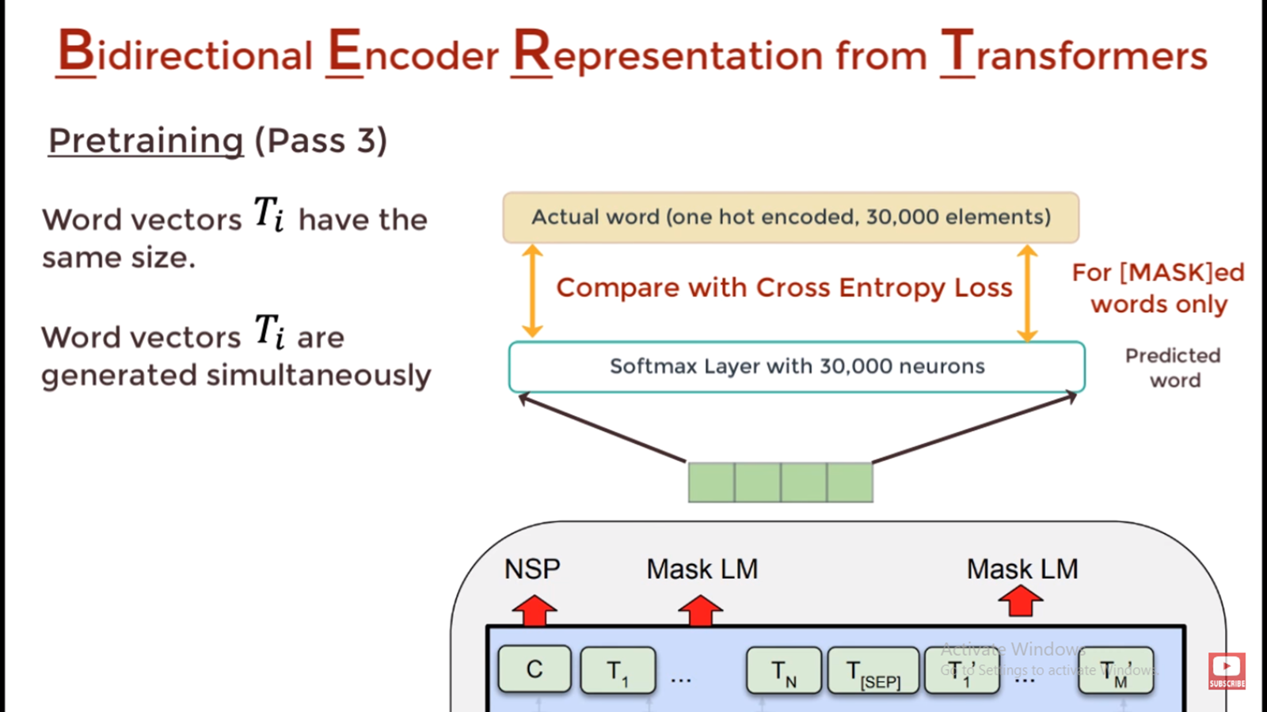
BERT- Pre-Training

Slide 23
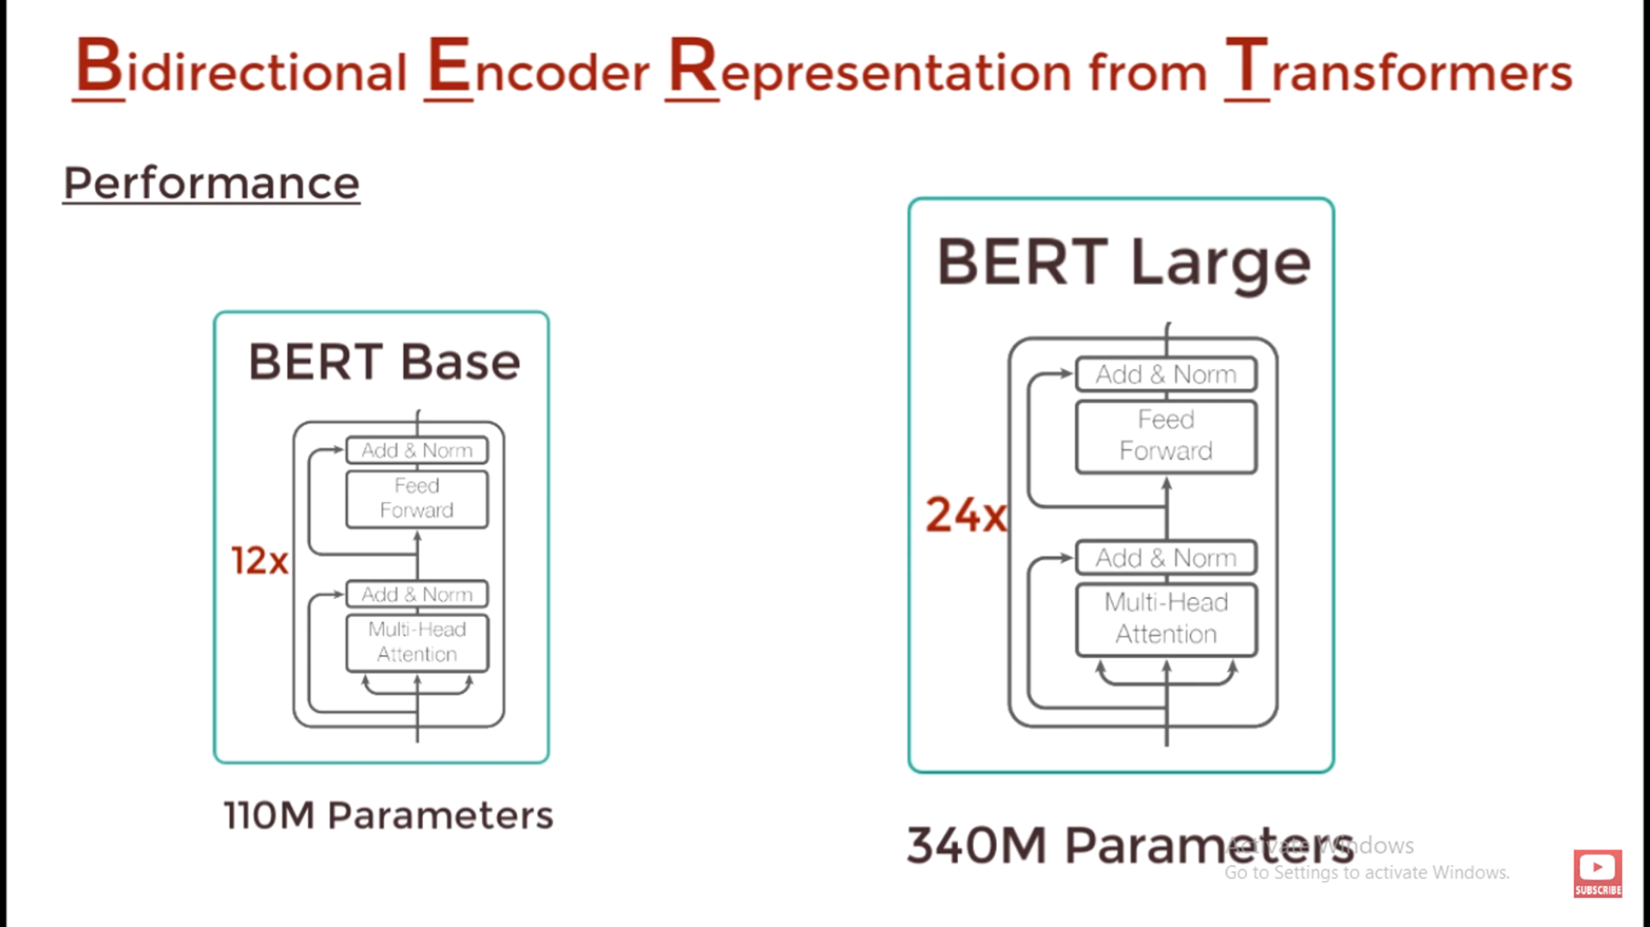
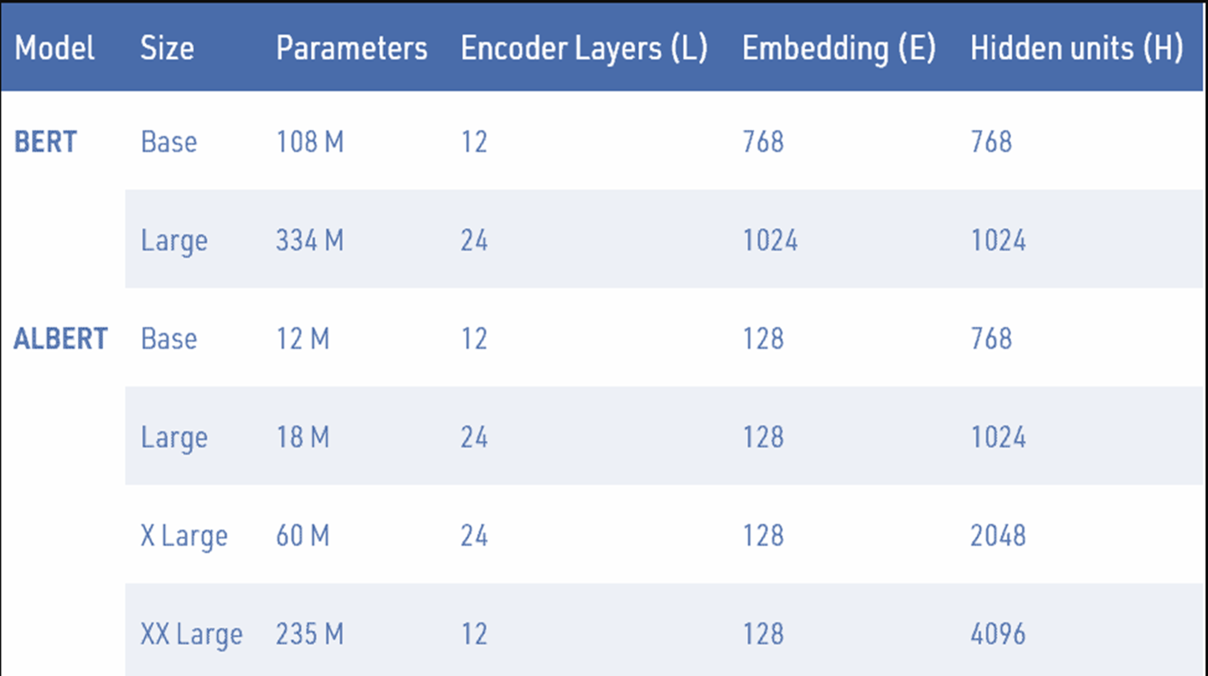
Types of BERT

Slide 24
PROMPTING STRATEGIES
Zero-Shot Learning
One-Shot Learning
Few-Shot Learning

Slide 25
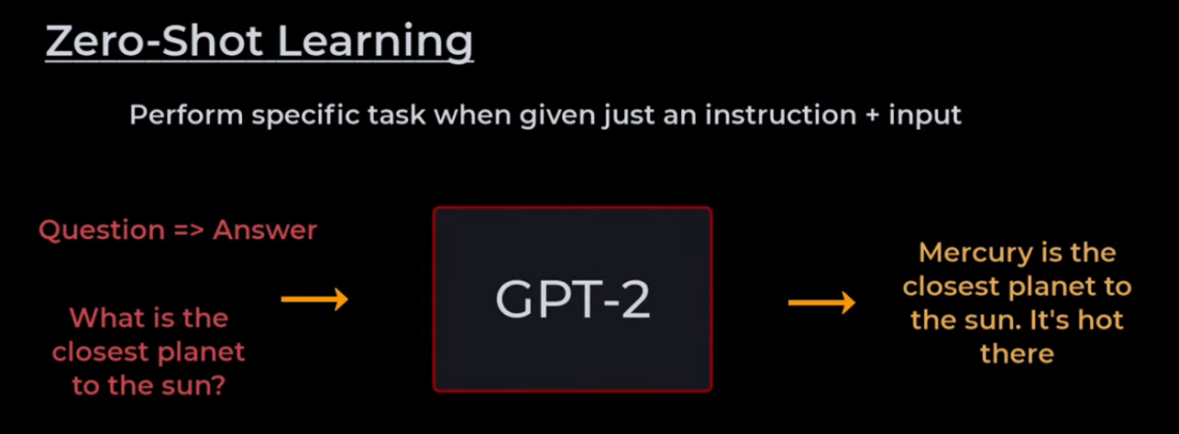
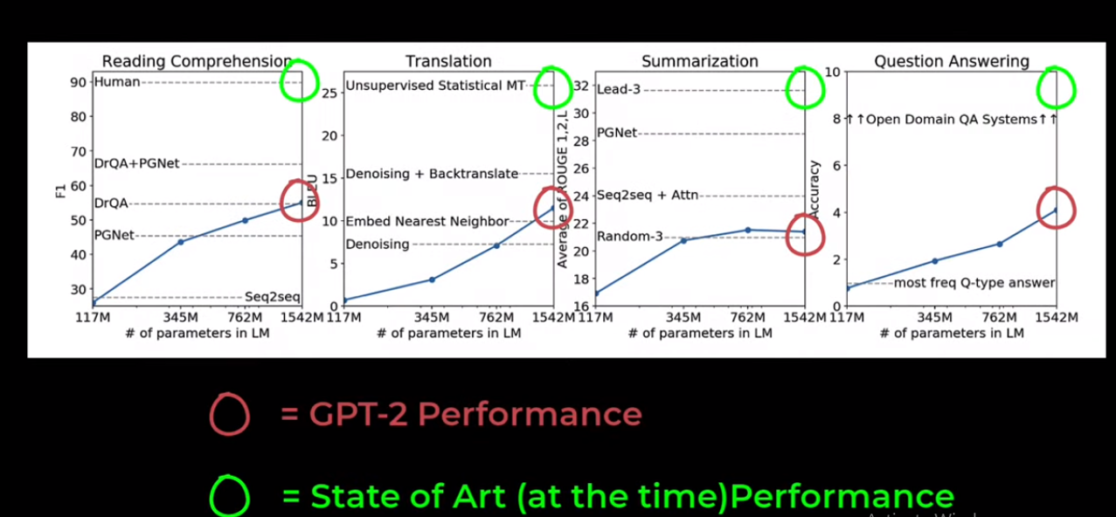
Zero-Shot Learning
In zero-shot prompting, the model is asked to perform a task without any examples.
It relies purely on:
Pretrained knowledge
General language understanding
Instruction clarity
When to use
Simple or well-defined tasks
Fast inference
When examples are unavailable
No prompt engineering effort
Low token usage
Example Prompt:
Classify the sentiment of the following text as Positive, Negative, or Neutral.
Text: "The product quality is excellent, but delivery was delayed."

Slide 26
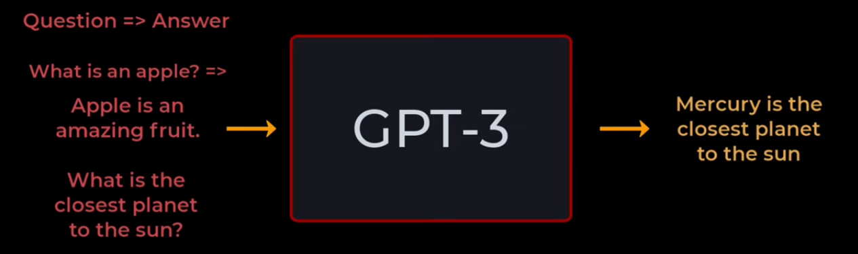
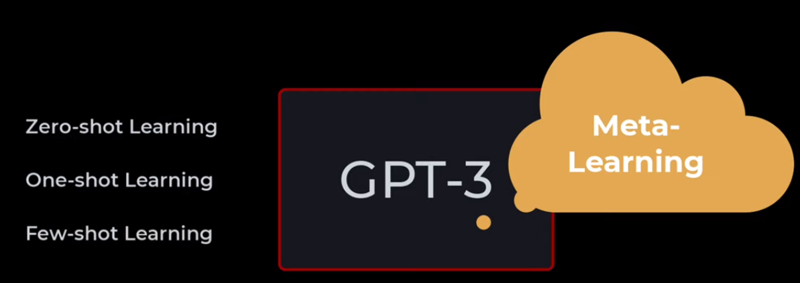
One-Shot Learning
In one-shot prompting, the model is given exactly one example before the actual query.
Strengths
Better formatting consistency
Improved accuracy over zero-shot
Minimal additional tokens
Example Prompt:
Classify the sentiment of the text.
Example:
Text: "I love this phone, it's amazing."
Sentiment: Positive
Now classify:
Text: "The app crashes frequently and is unusable."
Sentiment:

Slide 27
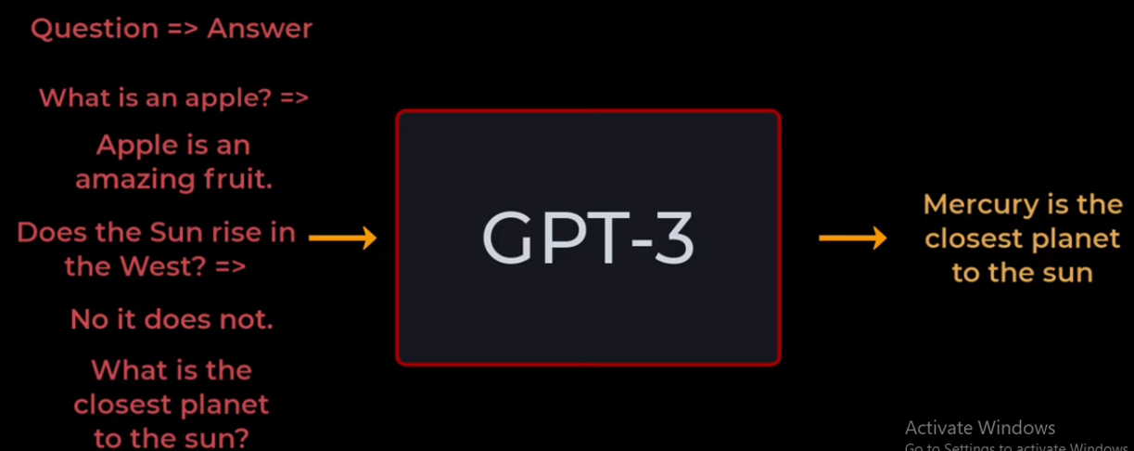
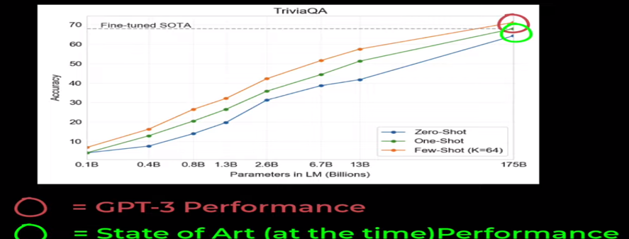
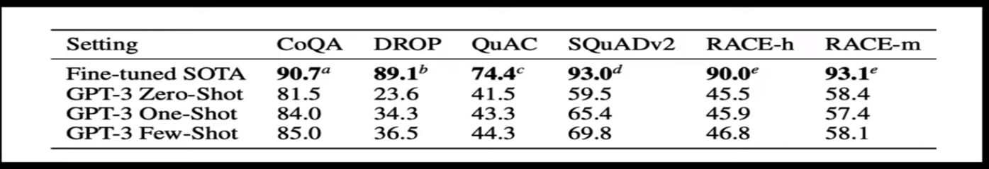
Few-Shot Learning
In few-shot prompting, the model is provided with multiple examples (typically 2–10).
Strengths:
Highest accuracy
Better reasoning alignment
Strong performance on complex tasks
Example Prompt:
Classify the sentiment of the text.
Example 1:
Text: "This laptop is fast and lightweight."
Sentiment: Positive
Example 2:
Text: "Customer support was rude and unhelpful."
Sentiment: Negative
Now classify:
Text: "Battery life is poor and overheating issues persist."
Sentiment:

Slide 28
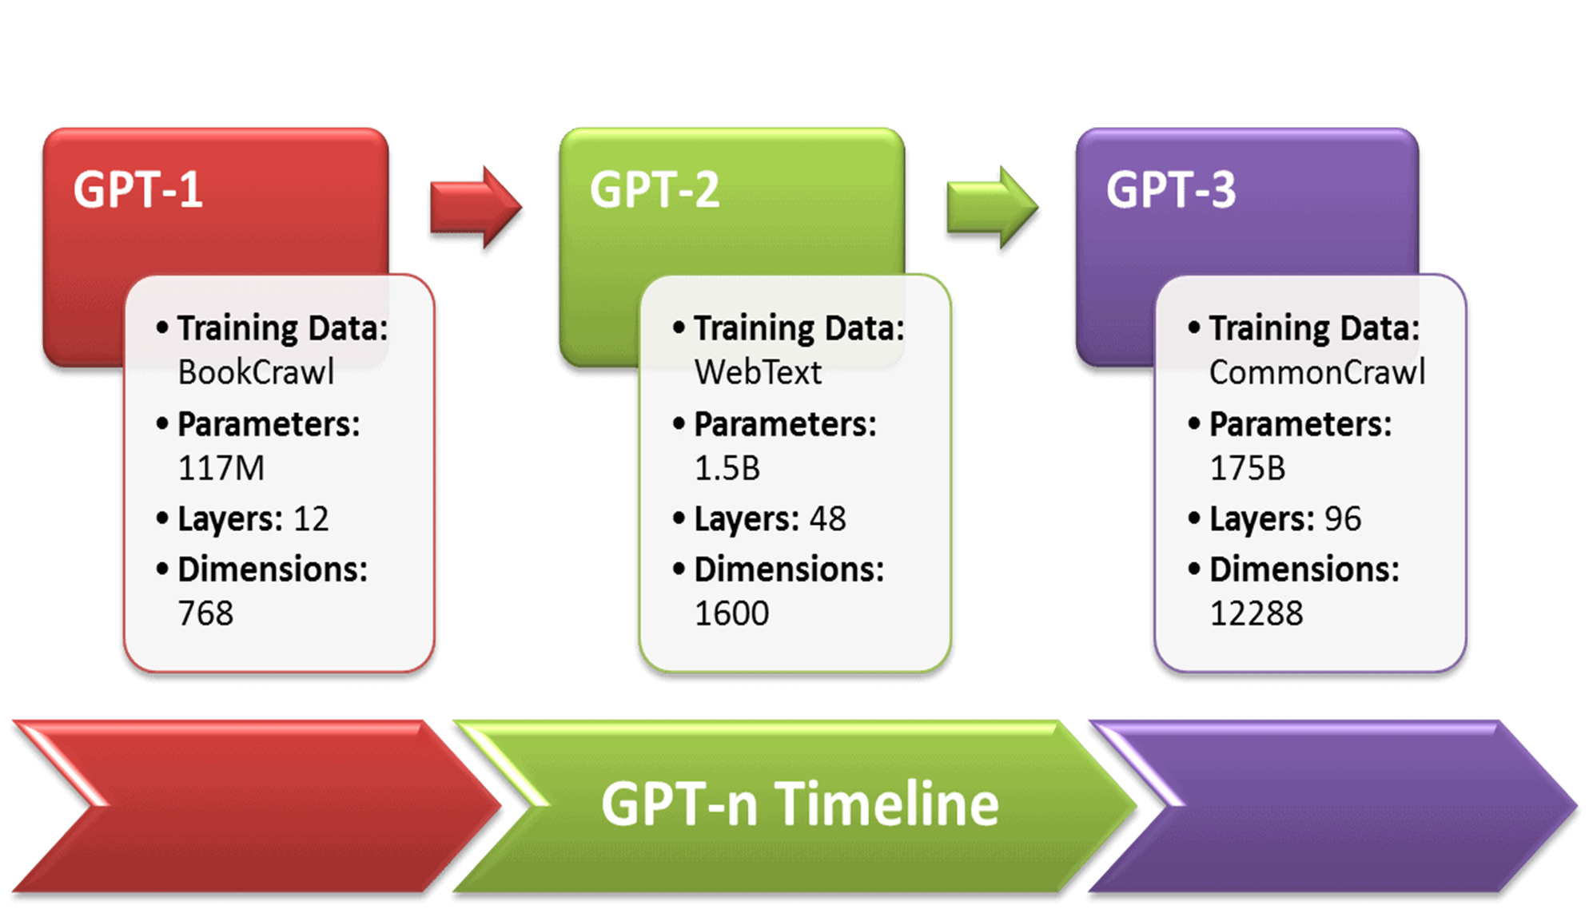

Slide 29
Hands-on
HuggingFace Walkthrough - Run colab model, cloud models, inference models
HuggingFace Spaces
https://github.com/Jaish19/NLP-IITD/blob/main/Transformer%20%26%20BERT/LLM_Text_playaround.ipynb
https://github.com/Jaish19/NLP-IITD/blob/main/Transformer%20%26%20BERT/Summarize_Bot_With_Inference.ipynb
https://github.com/Jaish19/NLP-IITD/blob/main/Transformer%20%26%20BERT/BERT_Classification_Base_FineTune.ipynb

